Slide 1
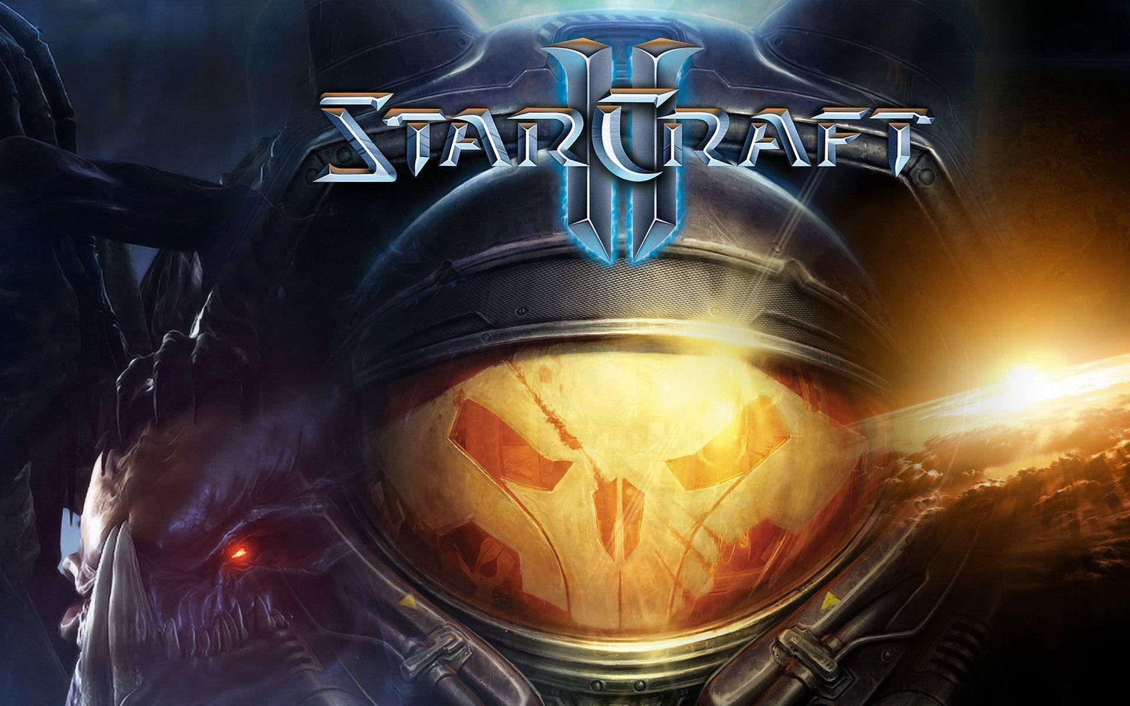
Starcraft2
BuILD RECOMMENDATION PROJECT
2013104051 컴퓨터공학과 김기빈
2014104110 컴퓨터공학과 신기성
2017104019 컴퓨터공학과 임에딘

Slide 2
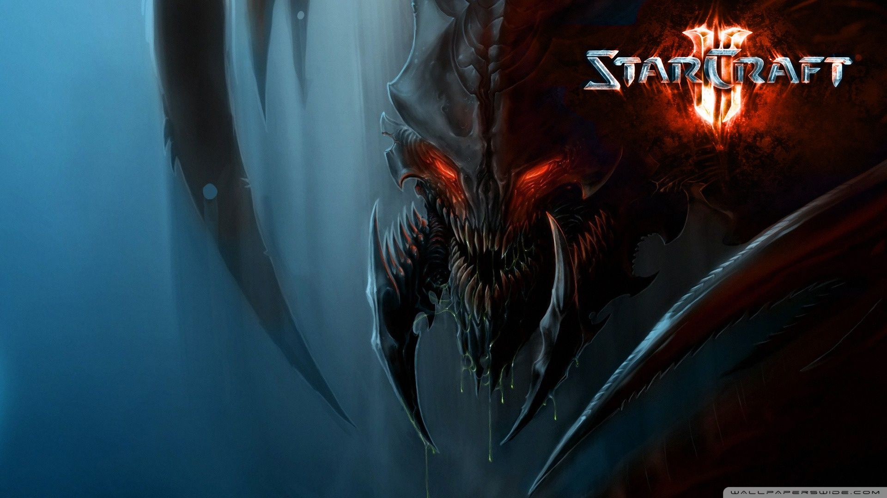
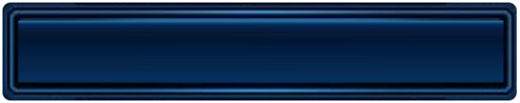
contents
Intro
Motivation
Architectures
Explanation
Part Distribution
Demo
Q & A

Slide 3
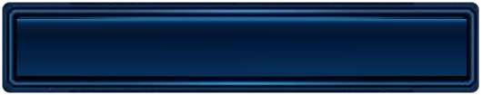

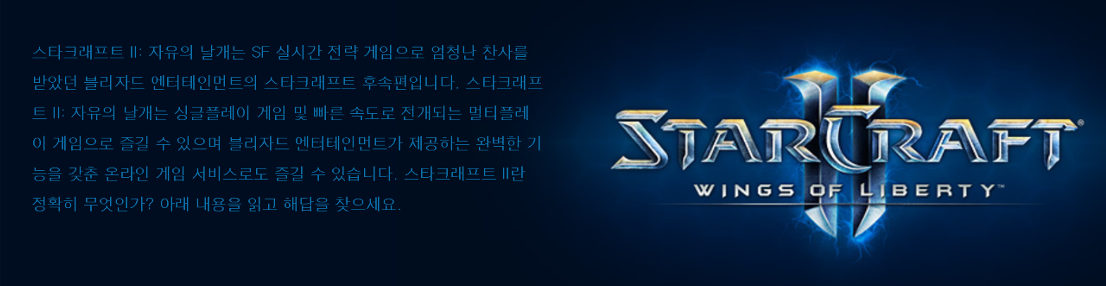
Intro
What is StarCraft2?

Slide 4
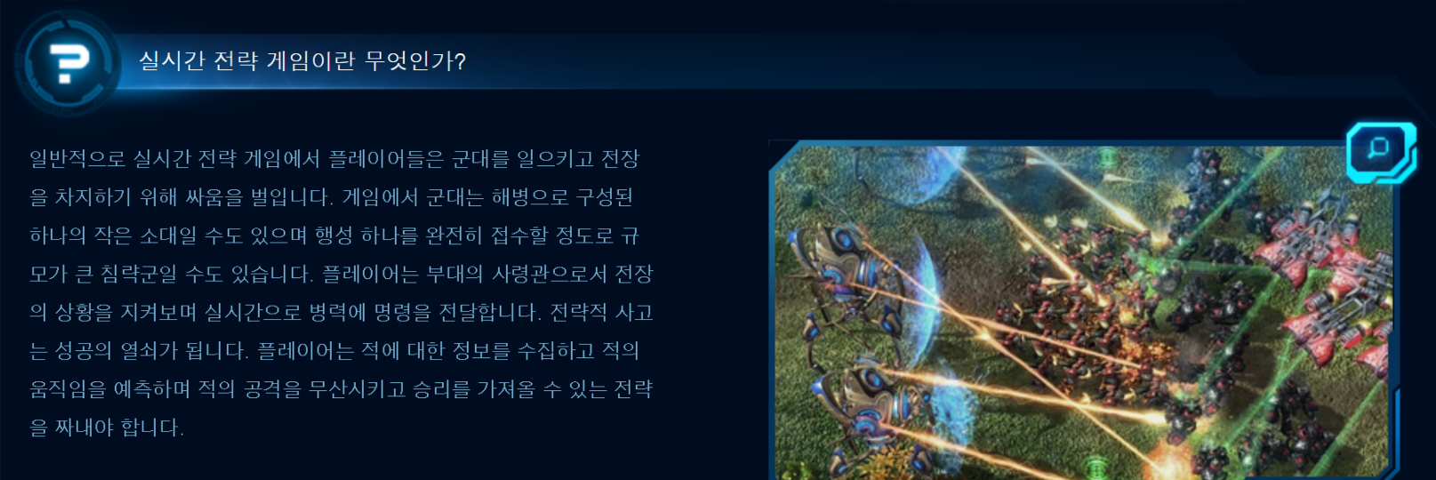
Intro
What is RTS game?

Slide 5
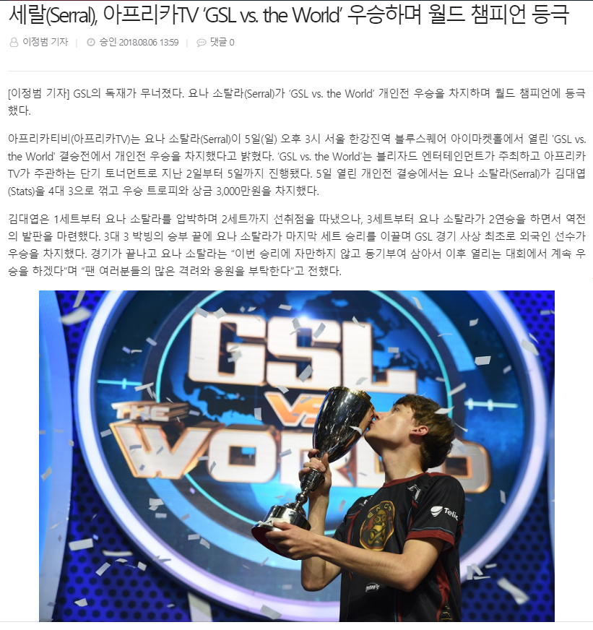
Intro
What is StarCraft2?

Slide 6
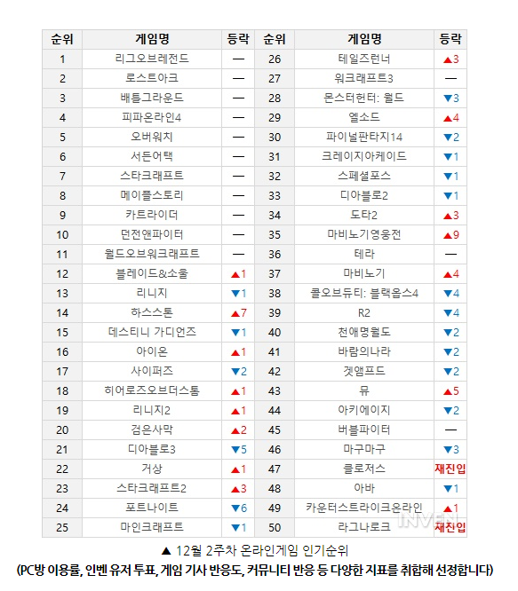
Intro
What is StarCraft2?

Slide 7
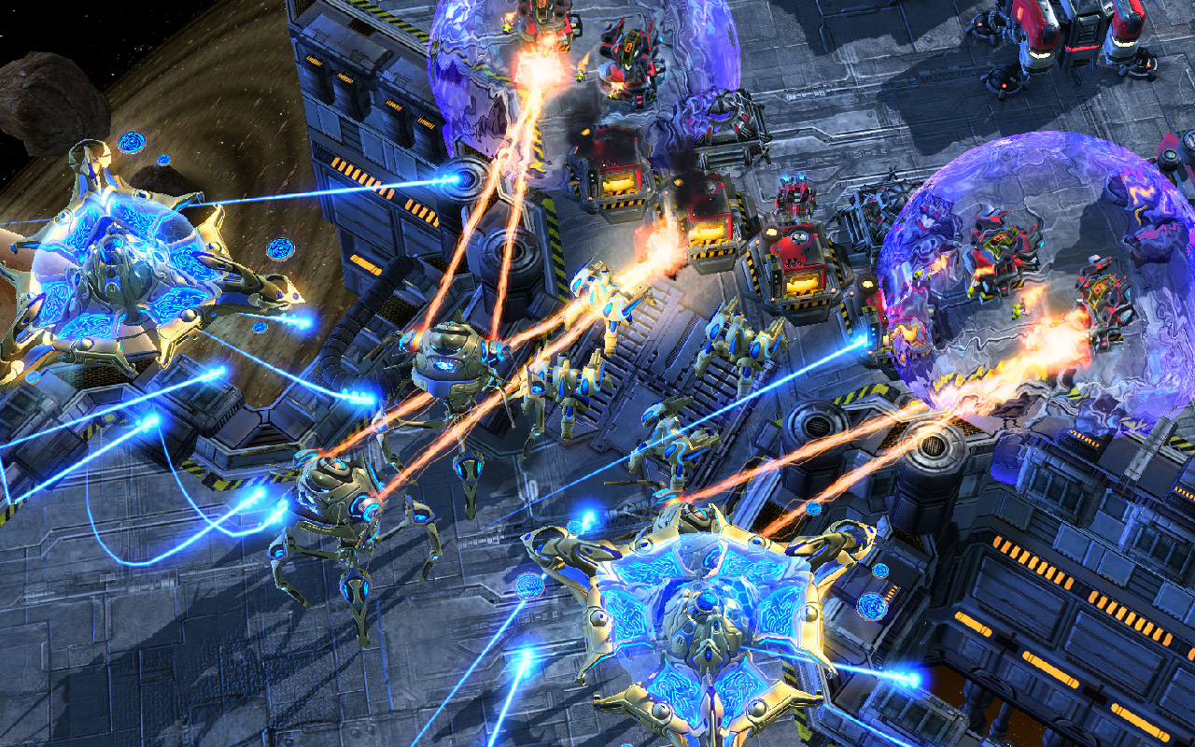
Intro
What is StarCraft2?

Slide 8
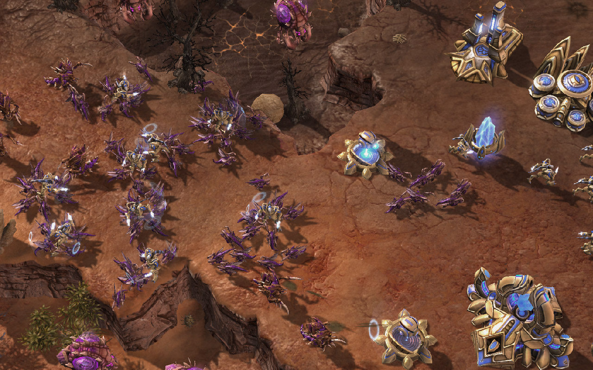
Intro
What is StarCraft2?

Slide 9
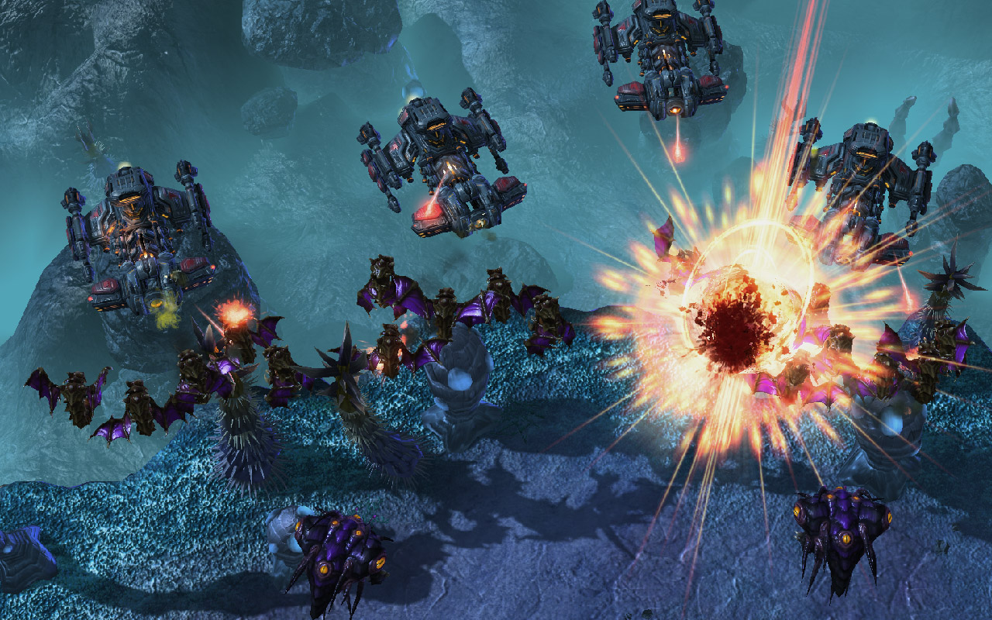
Intro
What is StarCraft2?

Slide 10

Motivation
Let's apply it to other games!

Slide 11
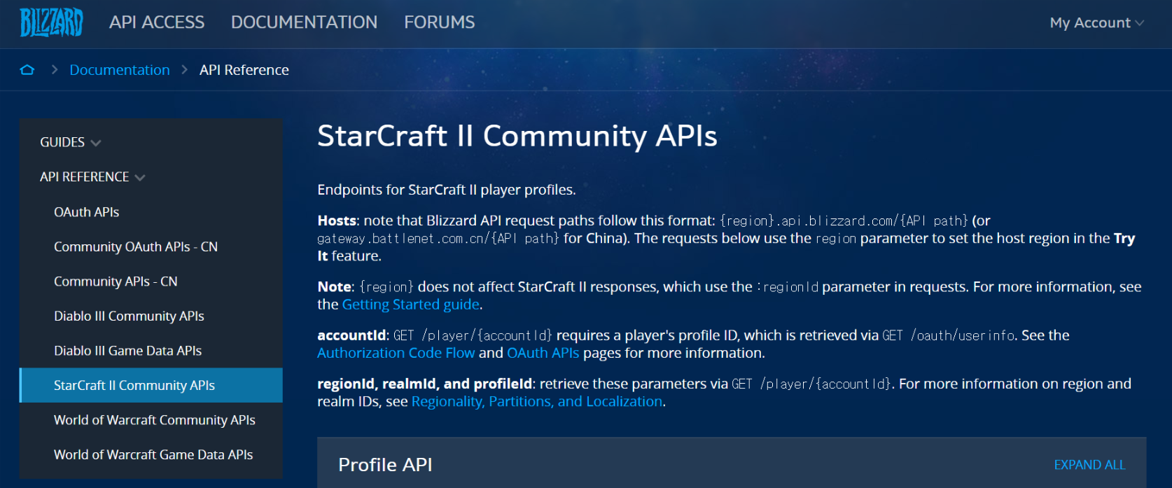
Motivation
Why StarCraft2 is chosen instead of StarCraft1

Slide 12
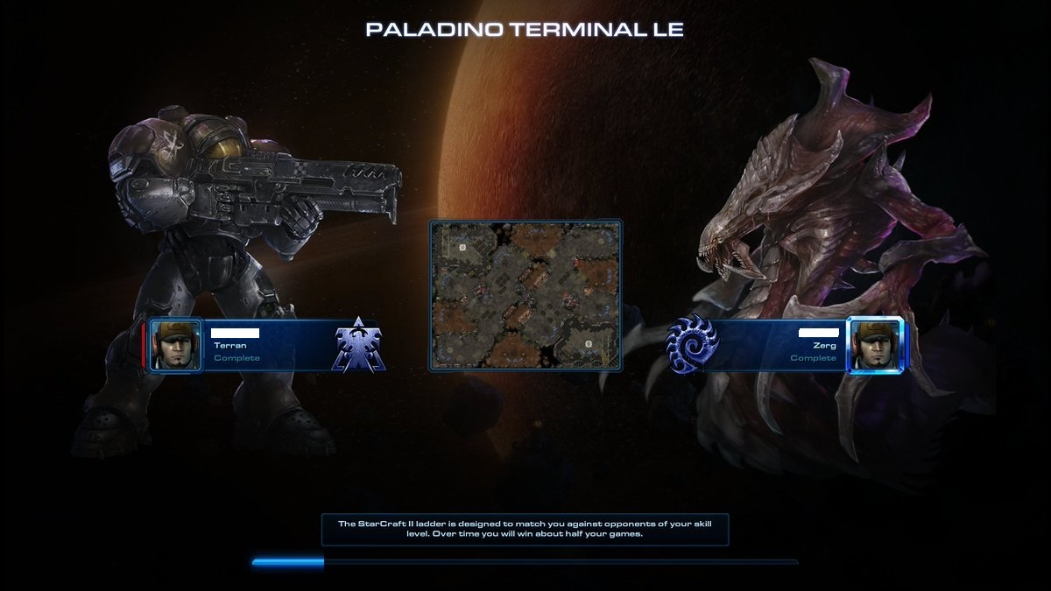
Motivation
Matching

Slide 13




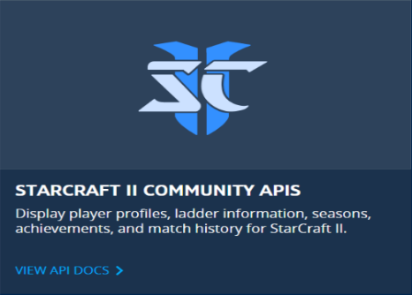
Architectures
Node.js + Express + AWS + Crawling + API

Slide 14
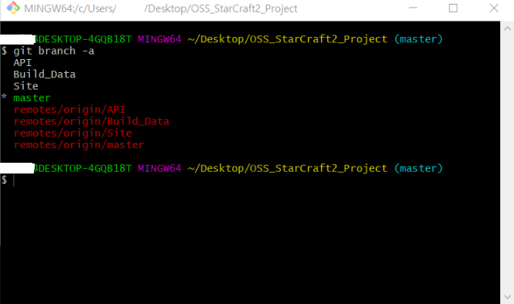
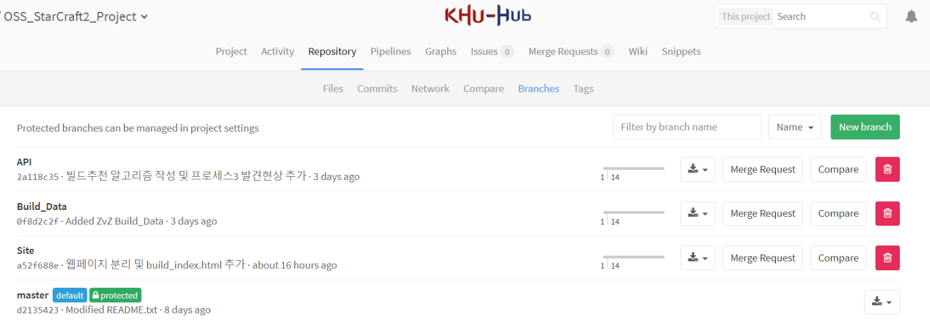
Architectures
We used Git and KhuHub for version control.

Slide 15
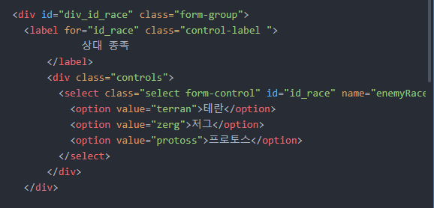
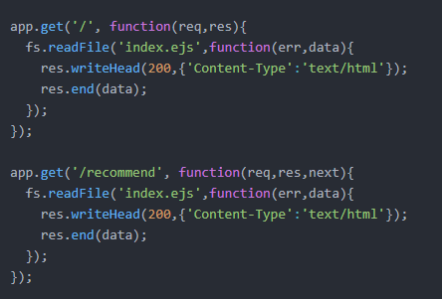
Explanation

Slide 16
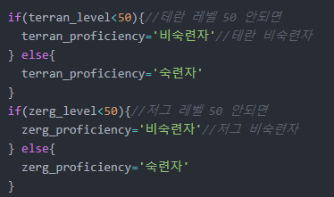
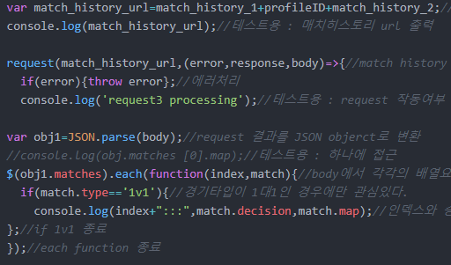
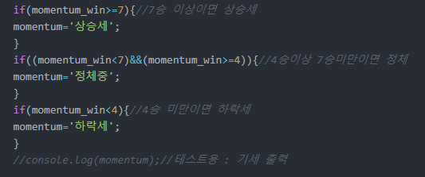
Explanation

Slide 17
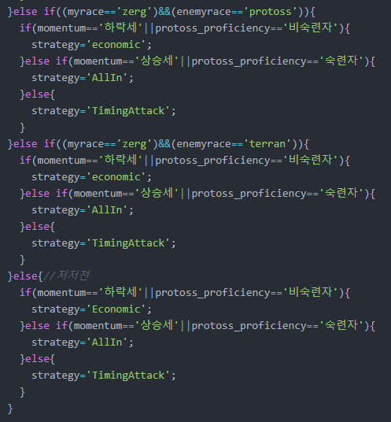
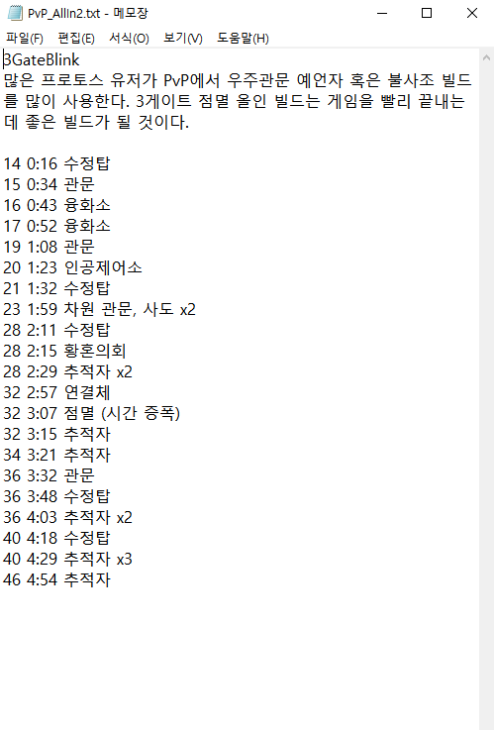
Explanation

Slide 18
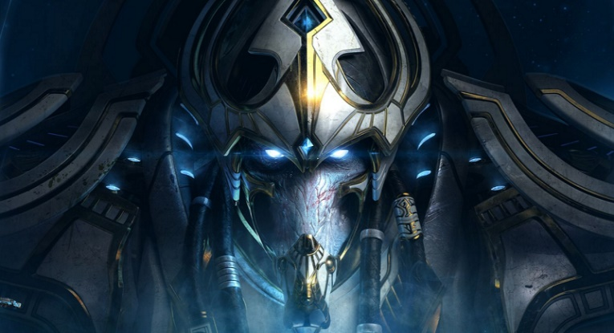
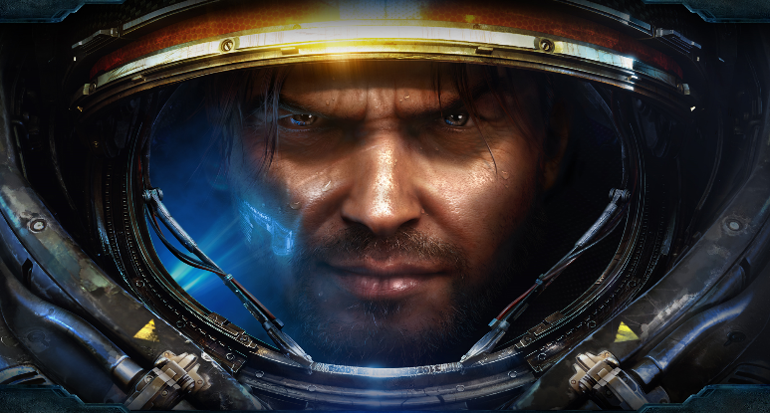

Part Distribution
We appropriately distributed the parts.
김기빈
신기성
임에딘
PM, Build Data, PPT
API, Crawling, Presentation
Site, AWS

Slide 19
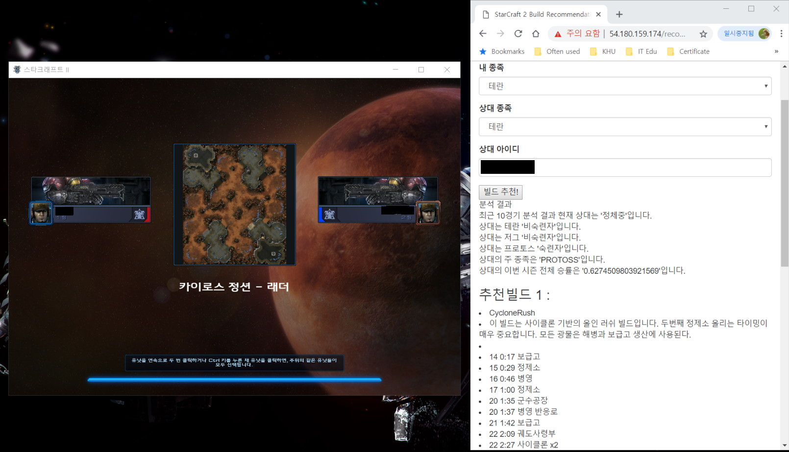
Demo
Screenshot

Slide 20
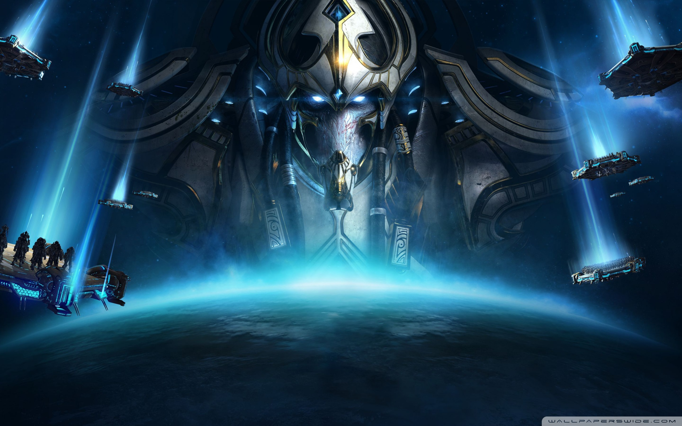
Q & A
Q & A

Slide 21
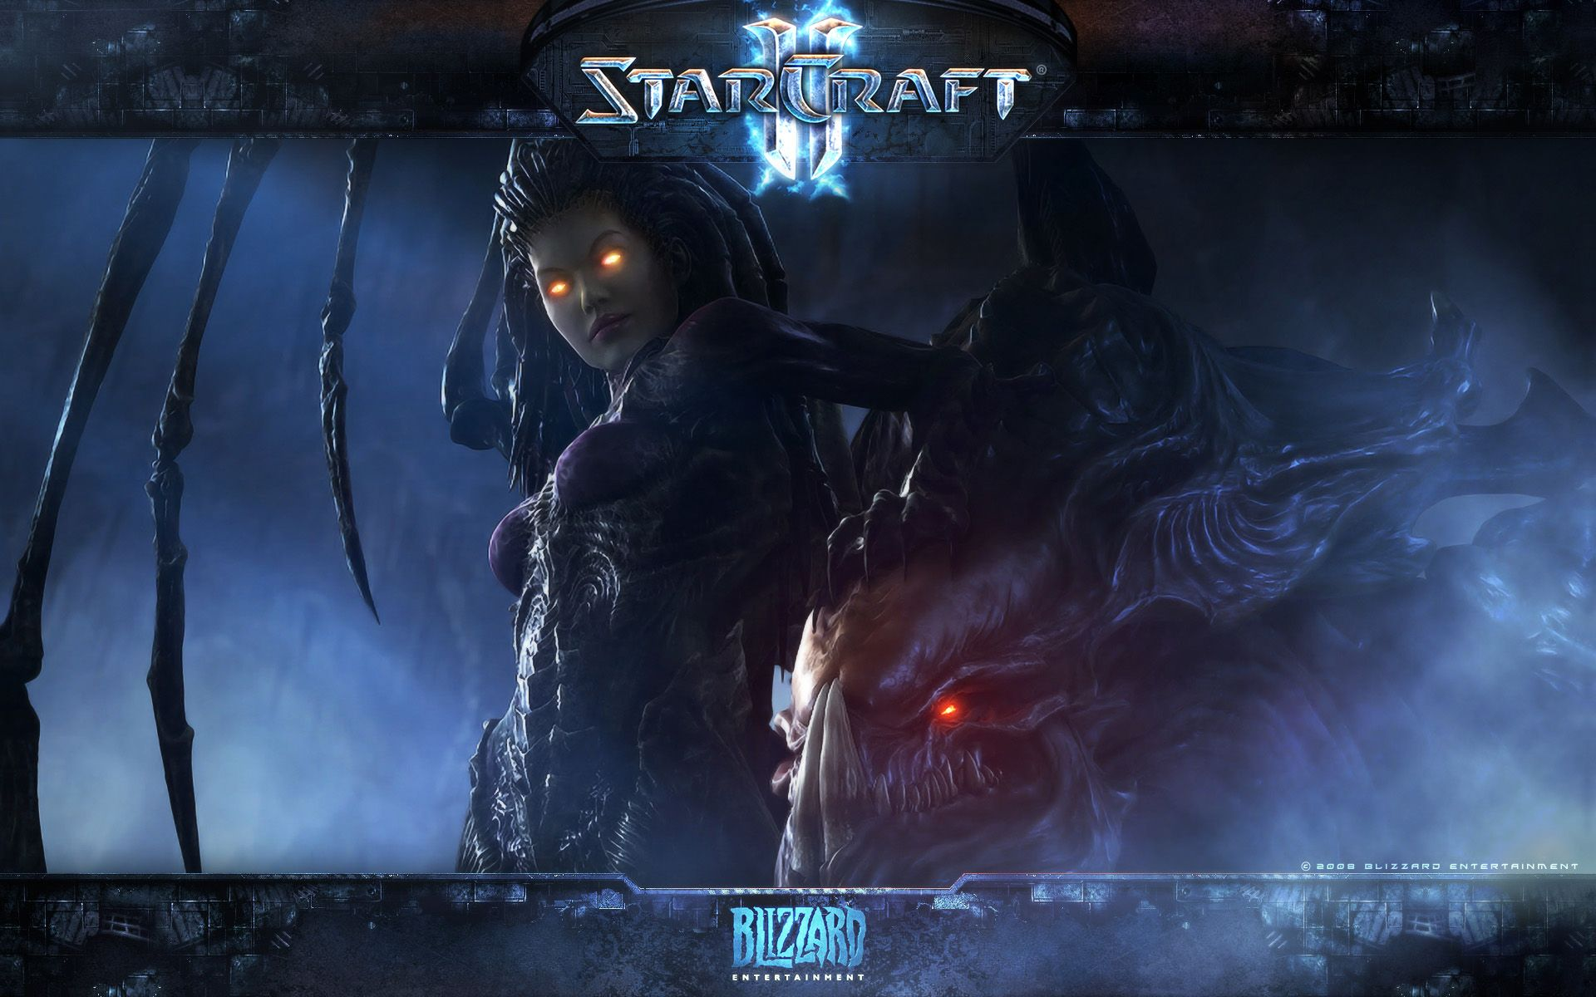
THANK YOU
“If you know your enemies and know yourself, you will not be imperiled in a hundred battles.“
-Sun Tzu-

